Slide 1

Introduction to Probability and Statistics
Twelfth Edition
Robert J. Beaver • Barbara M. Beaver • William Mendenhall
Presentation designed and written by:
Barbara M. Beaver

Slide 2
Introduction to Probability and Statistics
Twelfth Edition
Chapter 1
Describing Data with Graphs
Some graphic screen captures from Seeing Statistics ®
Some images © 2001-(current year) www.arttoday.com

Slide 3
Variables and Data
A variable is a characteristic that changes or varies over time and/or for different individuals or objects under consideration.
Examples: Hair color, white blood cell count, time to failure of a computer component.

Slide 4
Definitions
An experimental unit is the individual or object on which a variable is measured.
A measurement results when a variable is actually measured on an experimental unit.
A set of measurements, called data, can be either a sample or a population.

Slide 5
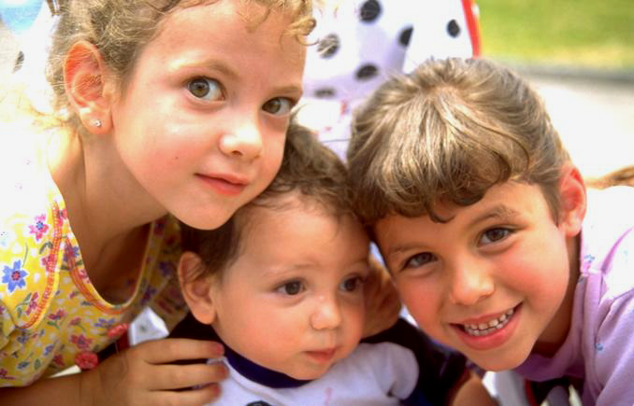
Example
Variable
  Hair color
Experimental unit
  Person
Typical Measurements
  Brown, black, blonde, etc.

Slide 6
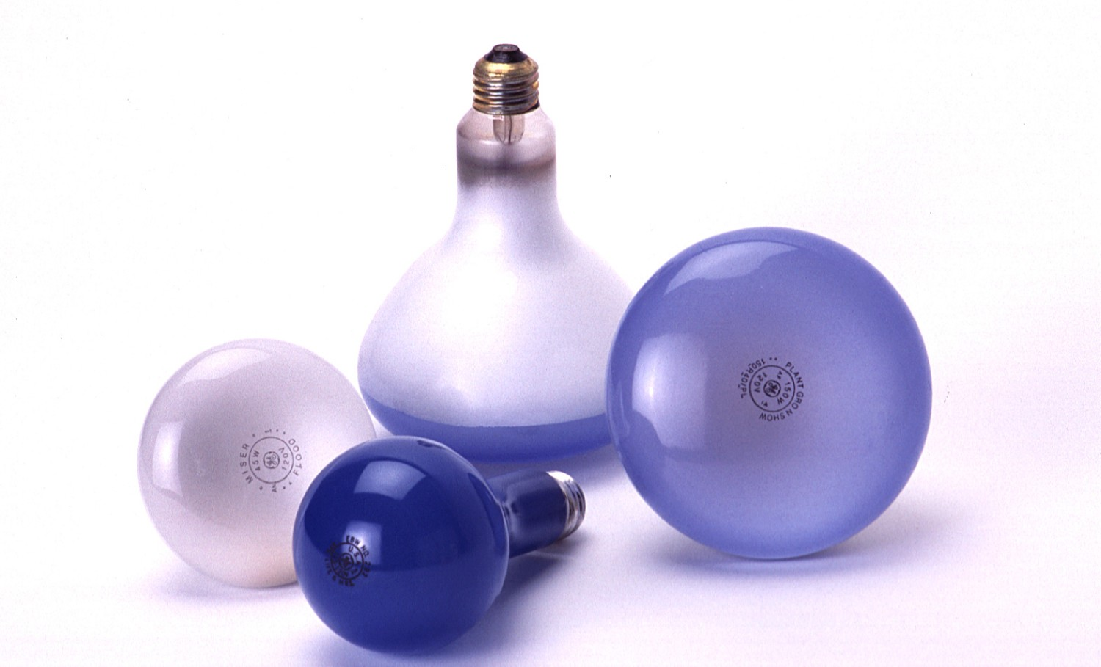
Example
Variable
  Time until a
  light bulb burns out
Experimental unit
  Light bulb
Typical Measurements
  1500 hours, 1535.5 hours, etc.

Slide 7
How many variables have you measured?
Univariate data: One variable is measured on a single experimental unit.
Bivariate data: Two variables are measured on a single experimental unit.
Multivariate data: More than two variables are measured on a single experimental unit.

Slide 8
Types of Variables
Qualitative
Quantitative
Discrete
Continuous

Slide 9
Types of Variables
Qualitative variables measure a quality or characteristic on each experimental unit.
Examples:
  Hair color (black, brown, blonde…)
  Make of car (Dodge, Honda, Ford…)
  Gender (male, female)
  State of birth (California, Arizona,….)

Slide 10
Types of Variables
Quantitative variables measure a numerical quantity on each experimental unit.
  Discrete if it can assume only a finite or countable number of values.
  Continuous if it can assume the infinitely many values corresponding to the points on a line interval.

Slide 11
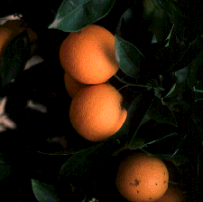
Examples
For each orange tree in a grove, the number of oranges is measured.
  Quantitative discrete
For a particular day, the number of cars entering a college campus is measured.
  Quantitative discrete
Time until a light bulb burns out
  Quantitative continuous

Slide 12
Graphing Qualitative Variables
Use a data distribution to describe:
  What values of the variable have been measured
  How often each value has occurred
“How often” can be measured 3 ways:
  Frequency
  Relative frequency = Frequency/n
  Percent = 100 x Relative frequency

Slide 13
Example
A bag of M&Ms contains 25 candies:
Raw Data:
Statistical Table:
m
m
m
m
m
m
m
m
m
m
m
m
m
m
m
m
m
m
m
m
m
m
m
m
m
Color | Tally | Frequency | Relative Frequency | Percent
Red |  | 3 | 3/25 = .12 | 12%
Blue |  | 6 | 6/25 = .24 | 24%
Green |  | 4 | 4/25 = .16 | 16%
Orange |  | 5 | 5/25 = .20 | 20%
Brown |  | 3 | 3/25 = .12 | 12%
Yellow |  | 4 | 4/25 = .16 | 16%
m
m
m
m
m
m
m
m
m
m
m
m
m
m
m
m
m
m
m
m
m
m
m
m
m

Slide 14
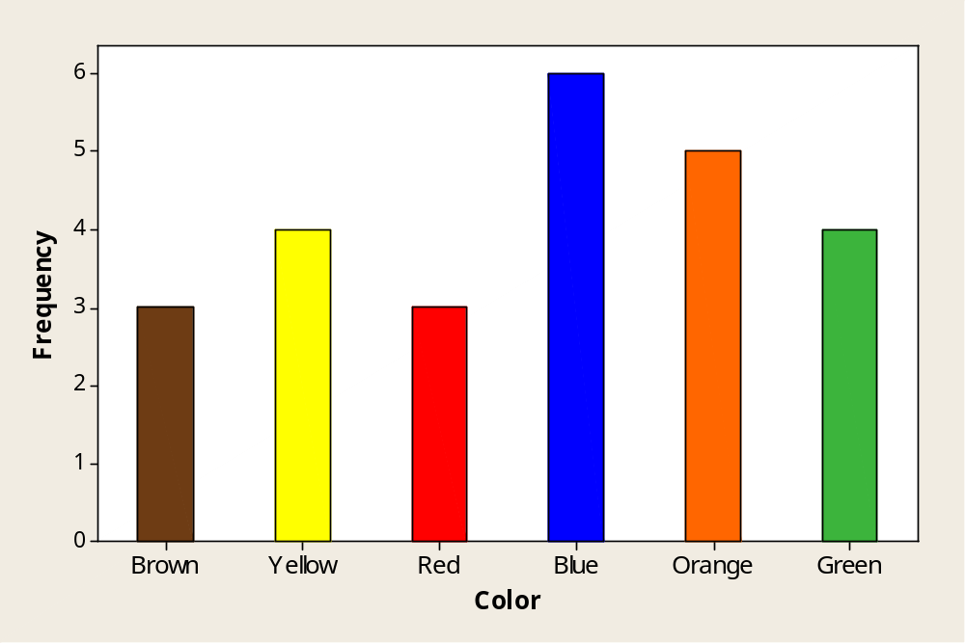
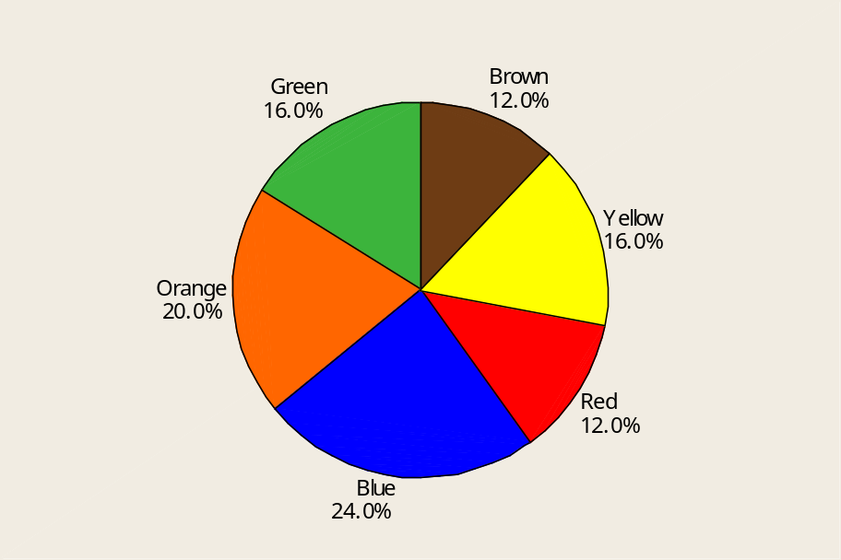
Graphs
Bar Chart
Pie Chart

Slide 15
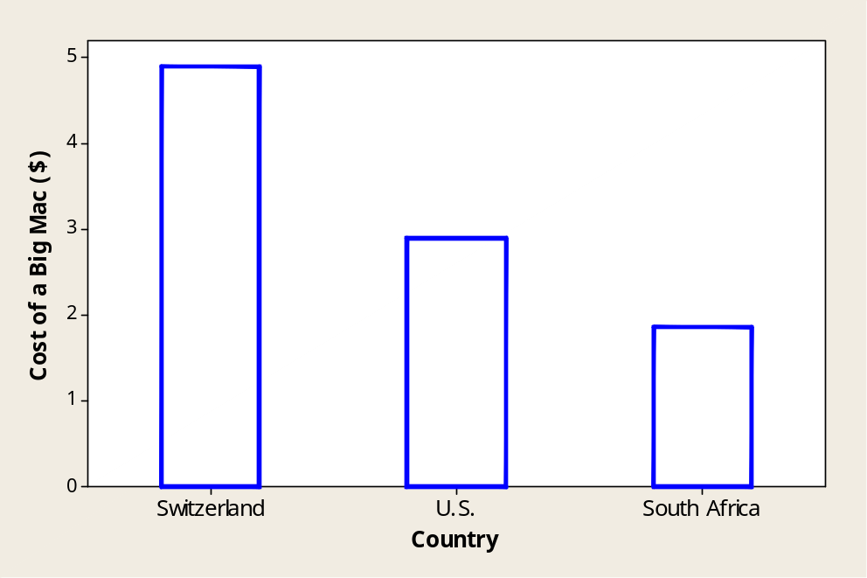
Graphing Quantitative Variables
A single quantitative variable measured for different population segments or for different categories of classification can be graphed using a pie or bar chart.
A Big Mac hamburger costs $4.90 in Switzerland, $2.90 in the U.S. and $1.86 in South Africa.

Slide 16
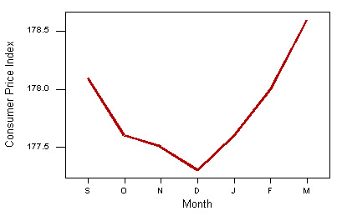
A single quantitative variable measured over time is called a time series. It can be graphed using a line or bar chart.
CPI: All Urban Consumers-Seasonally Adjusted
September | October | November | December | January | February | March
178.10 | 177.60 | 177.50 | 177.30 | 177.60 | 178.00 | 178.60
BUREAU OF LABOR STATISTICS

Slide 17
Dotplots
MY
APPLET
The simplest graph for quantitative data
Plots the measurements as points on a horizontal axis, stacking the points that duplicate existing points.
Example: The set 4, 5, 5, 7, 6
4 5 6 7

Slide 18
Stem and Leaf Plots
A simple graph for quantitative data
Uses the actual numerical values of each data point.
  Divide each measurement into two parts: the stem and the leaf.
  List the stems in a column, with a vertical line to their right.
  For each measurement, record the leaf portion in the same row as its matching stem.
  Order the leaves from lowest to highest in each stem.
  Provide a key to your coding.

Slide 19
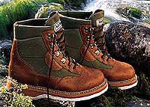
Example
The prices ($) of 18 brands of walking shoes:
90 70 70 70 75 70 65 68 60
74 70 95 75 70 68 65 40 65
4 0
5
6 5 8 0 8 5 5
7 0 0 0 5 0 4 0 5 0
8
9 0 5
4 0
5
6 0 5 5 5 8 8
7 0 0 0 0 0 0 4 5 5
8
9 0 5
Reorder

Slide 20
Interpreting Graphs:
Location and Spread
Where is the data centered on the horizontal axis, and how does it spread out from the center?

Slide 21
Interpreting Graphs: Shapes
Mound shaped and symmetric (mirror images)
Skewed right: a few unusually large measurements
Skewed left: a few unusually small measurements
Bimodal: two local peaks

Slide 22
Interpreting Graphs: Outliers
No Outliers
Outlier
Are there any strange or unusual measurements that stand out in the data set?

Slide 23


Example
A quality control process measures the diameter of a gear being made by a machine (cm). The technician records 15 diameters, but inadvertently makes a typing mistake on the second entry.
1.991 1.891 1.991 1.988 1.993 1.989 1.990 1.988
1.988 1.993 1.991 1.989 1.989 1.993 1.990 1.994

Slide 24
Relative Frequency Histograms
A relative frequency histogram for a quantitative data set is a bar graph in which the height of the bar shows “how often” (measured as a proportion or relative frequency) measurements fall in a particular class or subinterval.
Create intervals
Stack and draw bars

Slide 25
Relative Frequency Histograms
Divide the range of the data into 5-12 subintervals of equal length.
Calculate the approximate width of the subinterval as Range/number of subintervals.
Round the approximate width up to a convenient value.
Use the method of left inclusion, including the left endpoint, but not the right in your tally.
Create a statistical table including the subintervals, their frequencies and relative frequencies.

Slide 26
Relative Frequency Histograms
Draw the relative frequency histogram, plotting the subintervals on the horizontal axis and the relative frequencies on the vertical axis.
The height of the bar represents
  The proportion of measurements falling in that class or subinterval.
  The probability that a single measurement, drawn at random from the set, will belong to that class or subinterval.

Slide 27

Example
The ages of 50 tenured faculty at a
state university.
34 48 70 63 52 52 35 50 37 43 53 43 52 44
42 31 36 48 43 26 58 62 49 34 48 53 39 45
34 59 34 66 40 59 36 41 35 36 62 34 38 28
43 50 30 43 32 44 58 53
We choose to use 6 intervals.
Minimum class width = (70 – 26)/6 = 7.33
Convenient class width = 8
Use 6 classes of length 8, starting at 25.

Slide 28
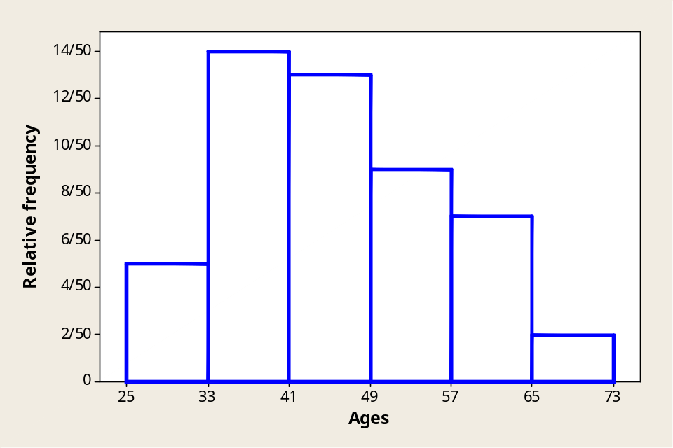
Age | Tally | Frequency | Relative Frequency | Percent
25 to < 33 | 1111 | 5 | 5/50 = .10 | 10%
33 to < 41 | 1111 1111 1111 | 14 | 14/50 = .28 | 28%
41 to < 49 | 1111 1111 111 | 13 | 13/50 = .26 | 26%
49 to < 57 | 1111 1111 | 9 | 9/50 = .18 | 18%
57 to < 65 | 1111 11 | 7 | 7/50 = .14 | 14%
65 to < 73 | 11 | 2 | 2/50 = .04 | 4%

Slide 29

Describing the Distribution
Shape?
Outliers?
What proportion of the tenured faculty are younger than 41?
What is the probability that a randomly selected faculty member is 49 or older?
Skewed right
No.
(14 + 5)/50 = 19/50 = .38
(8 + 7 + 2)/50 = 17/50 = .34

Slide 30
Key Concepts
I. How Data Are Generated
1. Experimental units, variables, measurements
2. Samples and populations
3. Univariate, bivariate, and multivariate data
II. Types of Variables
1. Qualitative or categorical
2. Quantitative
a. Discrete
b. Continuous
III. Graphs for Univariate Data Distributions
1. Qualitative or categorical data
a. Pie charts
b. Bar charts

Slide 31
Key Concepts
2. Quantitative data
a. Pie and bar charts
b. Line charts
c. Dotplots
d. Stem and leaf plots
e. Relative frequency histograms
3. Describing data distributions
a. Shapes—symmetric, skewed left, skewed right,
unimodal, bimodal
b. Proportion of measurements in certain intervals
c. Outliers

